Slide 1
Marketing Performance Analysis & ROI Prediction
Insights + Machine Learning Model

Slide 2

Dataset Overview: Comprehensive Campaign Data
1
Campaign Records
Analysis draws from a robust dataset of 200,000 individual campaign records.
2
Diverse Channels
Data spans across key platforms: Facebook, Instagram, YouTube, Google Ads, and Email.
Key Metrics Tracked
3
Core performance indicators include ROI, Conversion Rate (CR), Click-Through Rate (CTR), Engagement Score, and Acquisition Cost.
4
12-Month Period
Insights are derived from a full year of campaign data, ensuring comprehensive trend analysis.
Here's how some of these key metrics are calculated:
# Creating core metrics
# CTR: Click-Through Rate
df["CTR"] = df["Clicks"] / df["Impressions"]
# CPC: Cost Per Click
df["CPC"] = df["Acquisition_Cost"] / df["Clicks"]
# CPM: Cost Per 1000 Impressions
df["CPM"] = (df["Acquisition_Cost"] / df["Impressions"]) * 1000

Slide 3
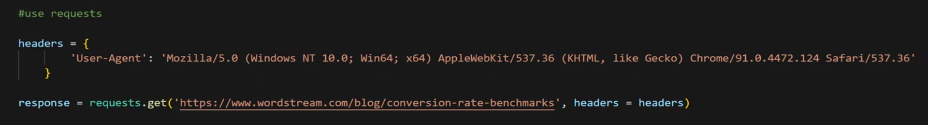
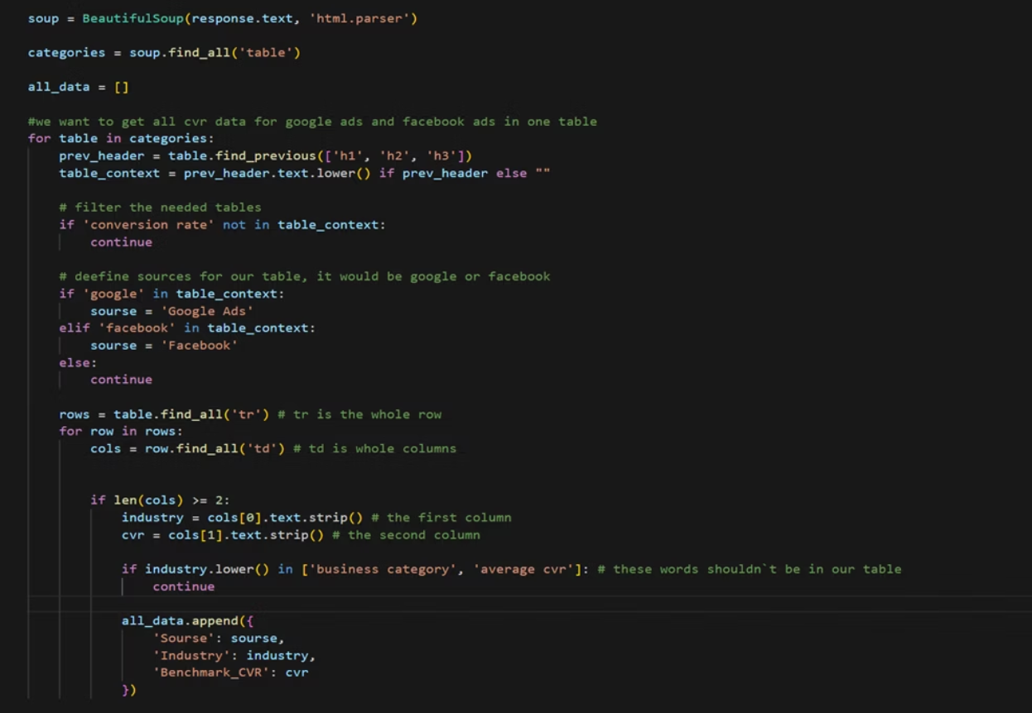
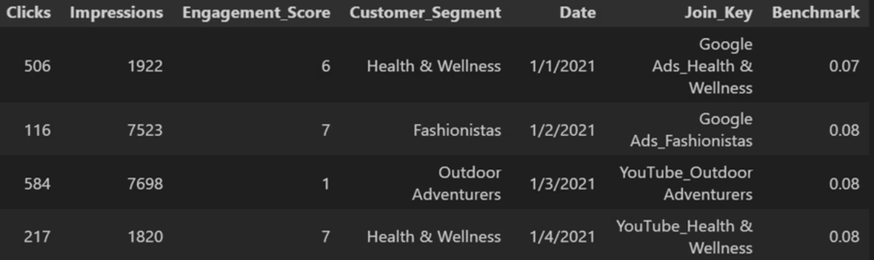
Data Acquisition & Benchmarking Methodology. Hybrid Scraping Approach.
Option 1: Request-Based Extraction (Direct)Demonstrates the ability to retrieve data efficiently by simulating HTTP requests and handling structured responses without overhead libraries.
Option 2: HTML Parsing via BeautifulSoup:Showcases proficiency in navigating and extracting data from complex DOM structures, ensuring flexibility when direct data access is restricted.
Data Estimation for Other Channels:• The project covers 6 marketing channels.
• For channels with missing public data, benchmarks were calculated by averaging metrics within each consumer category, ensuring a consistent baseline for the entire $2.50 Billion portfolio.
Outcome:A comprehensive, verified dataset that bridges the gap between internal performance and market standards, ready for analysis in Excel and ML.

Slide 4
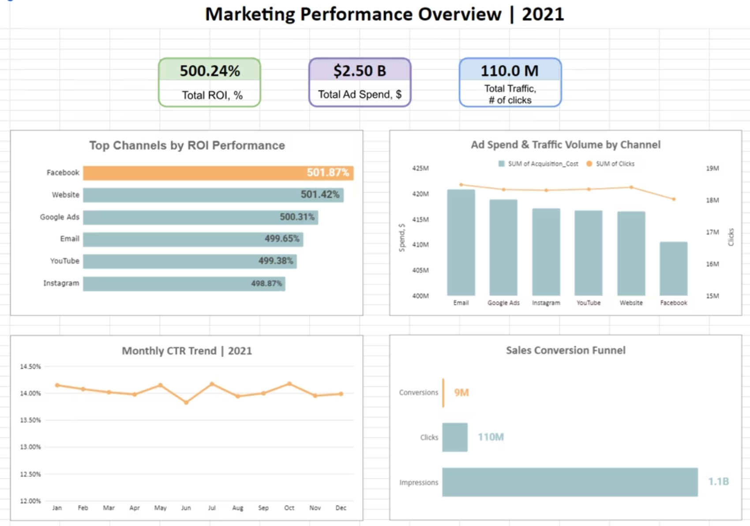
Connecting the Dots: From Granular Data to Executive Insights
The Big Picture:Our dashboard consolidates 1.1 Billion impressionsinto a single, real-time view, allowing for immediate
performance assessment across the entire
$2.50B portfolio.
Performance vs. Context: By integrating the scraped benchmarks directly into
the visual interface, we can see that while Facebookleads in ROI (501.87%), Google Ads remains the most consistent over-performer relative to market standards.
Strategic Stability:The dashboard highlights a remarkably stable CTR of ~14%, confirming that our audience targeting remains effective throughout the fiscal year.
Actionable Intelligence:This unified view allows us to spot the "Conversion Gap" in channels like Instagram and YouTube, directing our focus toward landing page optimization to match Facebook's efficiency.

Slide 5

Machine Learning Model: Predicting Future ROI
We've developed a Random Forest Regressor model to accurately predict campaign ROI, leveraging key performance drivers.
1
2
Model Type: Random Forest Regressor
Key Features Utilized
Engagement Score, Acquisition Cost, Channel, and Duration are the primary inputs for ROI prediction.
Selected for its ability to handle complex, non-linear relationships and robustness to noisy data.
3
Purpose: Proactive ROI Prediction
The model's core function is to forecast ROI for new or planned campaigns, enabling data-driven decision-making.

Slide 6
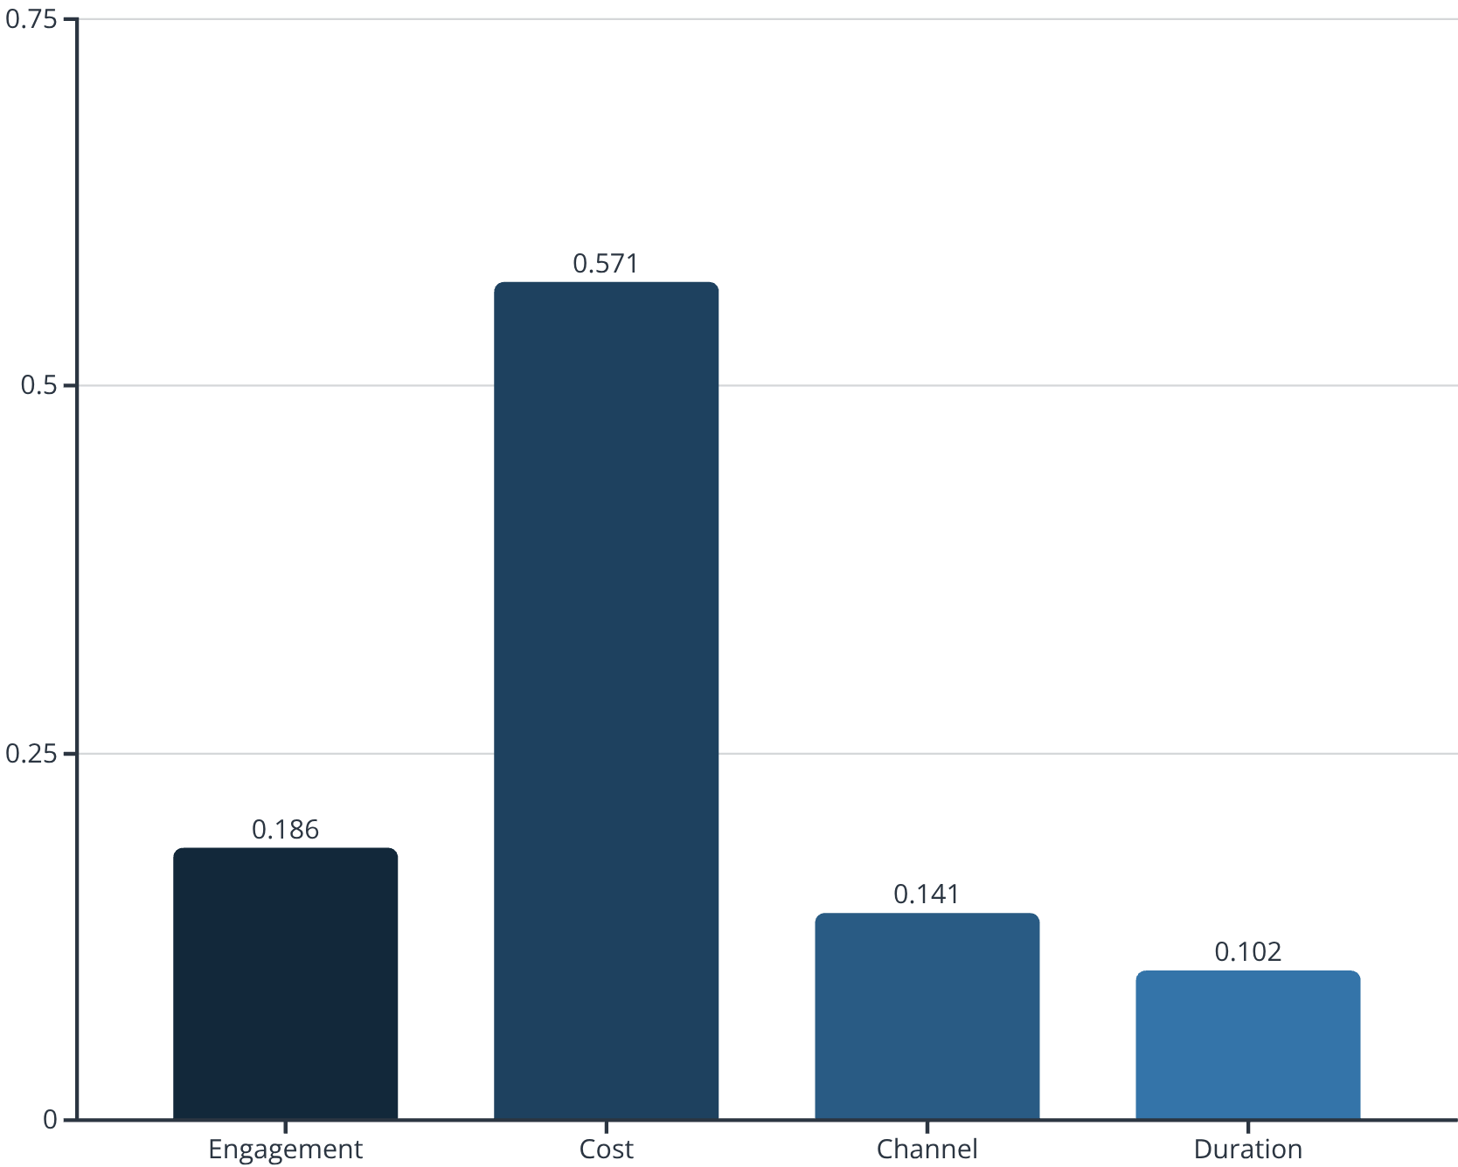
Feature Importance Analysis
This analysis reveals which variables have the most impact on ROI prediction, with Cost being the dominant factor influencing the model's output.
# Feature importance calculation code
feature_importances = model.feature_importances_
features = ['Engagement', 'Cost', 'Channel', 'Duration']
for feature, importance in zip(features, feature_importances):
print(f"{feature}: {importance:.3f}")
# Results:
Engagement: 0.186
Cost: 0.571
Channel: 0.141
Duration: 0.102

Slide 7
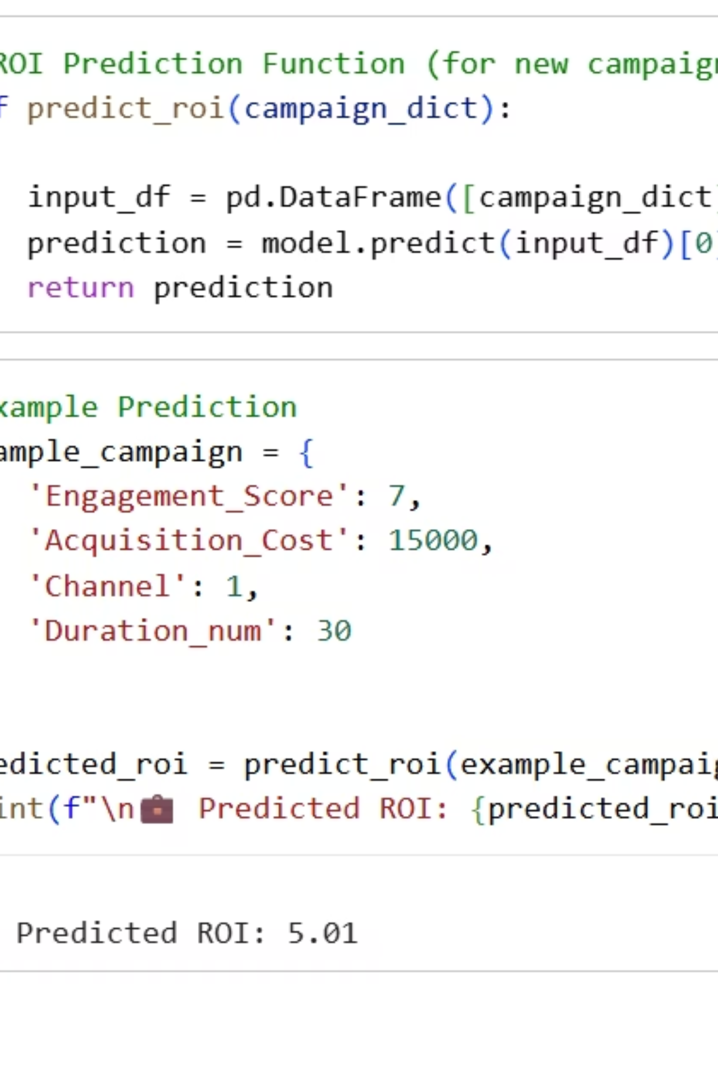
ROI Prediction in Action
This demonstrates how the model makes real-time predictions for new campaigns, enabling data-driven decision-making before campaign launch.

Slide 8
Model Performance: Understanding ROI Stability
Our model confirms the inherent stability of ROI across campaigns, providing reliable predictions for average performance.
1,5
~0
Mean Absolute Error (MAE)
R-squared (R²)
Average prediction mistake size = ±1.5 ROI points.
Expected due to low variance in ROI, indicating that the model reliably predicts the average ROI rather than individual fluctuations.
Since ROI ranges 2-8, this accuracy supports real budget allocation decisions between channels.
The low R² value is not a limitation but a reflection of the consistent ROI. This means the model excels at predicting the highly stable average ROI, which is invaluable for consistent budget allocation.

Slide 9


Strategic Recommendations: Optimizing for Growth
Increase Facebook Budget
Boost Facebook spend by 10-15% due to its consistently highest ROI and lowest acquisition cost, maximizing efficient returns.
Re-evaluate Email Spend
Conduct a thorough review of email marketing expenses. Its highest cost and lower efficiency suggest potential for budget reallocation or strategy refinement.
Improve CVR on YouTube & Instagram
Focus on optimizing conversion rates for YouTube and Instagram. Even a marginal +0.02% increase can translate to thousands of additional conversions.
Optimize Landing Page UX
Prioritize enhancing the user experience on landing pages, especially for mobile traffic originating from social channels, to reduce bounce rates and improve conversions.

